Slide 1

AADECS : Autonomous Accident Detection and Emergency Communication System
business slides

Slide 2

Group - 1
•2310040007 – U .Chaitanya Vignesh
•2310040106 – P .Lakshmi Reddy
•2310040126 – G .Sanjana
•2310049151 – K. Bhanu Praveen

Slide 3

introduction
Table Of Contents
introduction
Problem Statment
Literature Survey
Knowledge gap
Methodology
Expected Outcome
References

Slide 4

introduction.
The Autonomous Accident Detection and Emergency Communication System is developed to improve road safety by providing immediate and reliable accident reporting without human intervention. The system continuously monitors vehicle dynamics using sensors such as accelerometers, gyroscopes, and vibration sensors to detect sudden impacts, rollovers, or abnormal motion patterns associated with road accidents. An embedded controller processes sensor data in real time to accurately determine accident conditions while minimizing false alerts.
Once an accident is detected, the system automatically activates an emergency communication module integrated with GPS and wireless networks to transmit vital information, including the exact location, time of occurrence, and severity of the crash, to emergency services, hospitals, or predefined contacts. This rapid information exchange nables faster dispatch of rescue teams and medical assistance.
The proposed system is especially beneficial in remote or high-traffic areas where manual accident reporting may be delayed. By reducing response time and ensuring timely medical intervention, the system significantly increases the chances of saving lives. Overall, the system contributes to intelligent transportation solutions by enhancing vehicle safety, emergency preparedness, and road accident management.

Slide 5
Problem Statement:
Road accidents are one of the leading causes of injury and death, especially in situations where immediate medical assistance is not available. In many cases, accident victims are unable to call for help due to unconsciousness or severe injuries, leading to delays in emergency response. Existing emergency systems mainly depend on human intervention, which is unreliable during critical situations. Hence, there is a need for an autonomous system that can automatically detect road accidents and instantly communicate the location and severity of the accident to emergency services and nearby contacts to reduce response time and save lives.

Slide 6

Literature Survey:
Several studies have proposed sensor-based accident detection systems using accelerometers to identify sudden impacts.
To improve detection accuracy, gyroscopes and vibration sensors are combined to detect rollovers and abnormal motion.
GPS and GSM modules are widely used to send accident location and alert messages to emergency services.
Existing systems reduce response time but often suffer from false alerts, high cost, or limited reliability.
These limitations highlight the need for a low-cost, accurate, and autonomous accident detection system

Slide 7
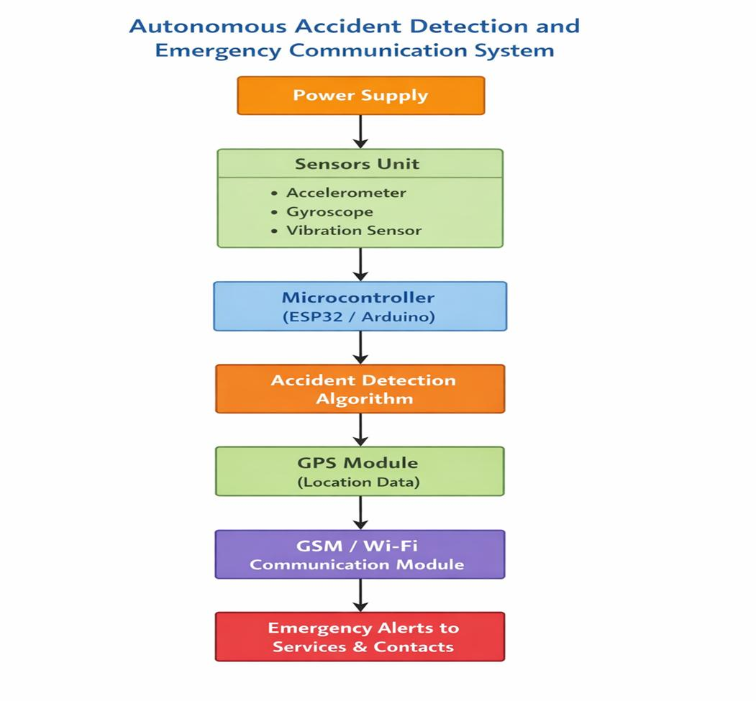
Block Diagram:

Slide 8
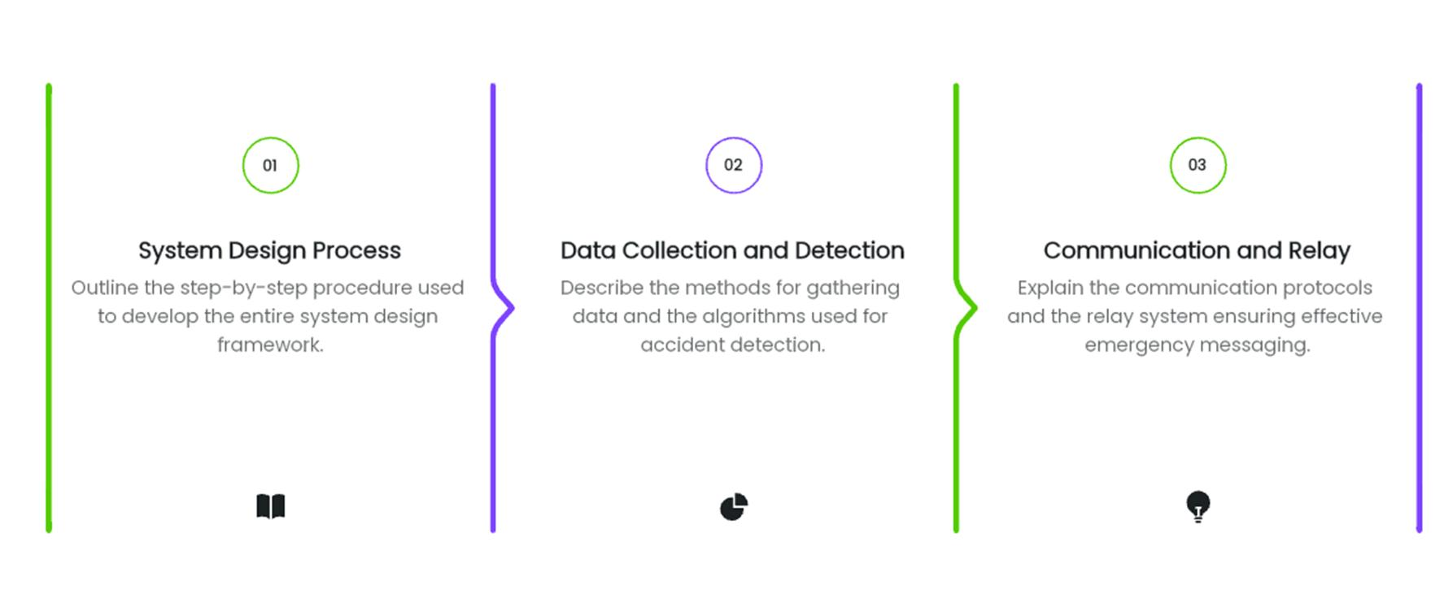
Methodology:

Slide 9

Expected Output / System Operation
When a vehicle meets with an accident in a forest or other remote area, the AADECS system is automatically activated.
Accident Detection
The onboard emergency device detects a crash using sensors and immediately triggers the response protocol.
User Verification Call
The system first places an automatic call to the vehicle user to verify their condition.
If the user responds, the system asks whether medical assistance is required.
Based on the user’s response, further action is taken.
No Response Scenario
If the user does not answer the call within a predefined time, the system assumes a critical emergency.

Slide 10
No Response Scenario
If the user does not answer the call within a predefined time, the system assumes a critical emergency.
Emergency Communication
The device automatically sends the exact GPS location coordinates of the accident to:
The nearest hospitals
Emergency services (ambulance and rescue teams)
•Rescue Arrival
Emergency responders are dispatched to the accident location, ensuring timely medical assistance even in isolated forest regions.

Slide 11


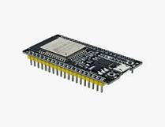
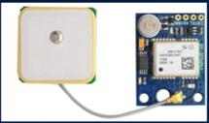
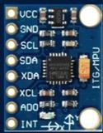
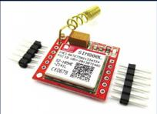
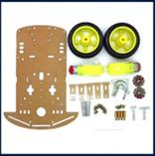
Components:

Slide 12
Reference:
•[1] A. Author et al., “Title of the Paper,” Journal Name, Year.
•https://penerbit.uthm.edu.my/periodicals/index.php/eeee/article/view/10622
•[2] “Smart Road Safety and Emergency Response System,” IJRASET, Year.
•https://www.ijraset.com/best-journal/smart-road-safety-and-emergency-response-system
•[3] Sensors Journal, MDPI, vol. 22, no. 6, 2022.
•https://www.mdpi.com/1424-8220/22/6/2077
•[4] Sustainability Journal, MDPI, vol. 17, no. 14, 2024.
•https://www.mdpi.com/2071-1050/17/14/6510

Slide 13
THANK YOU

